Slide 1
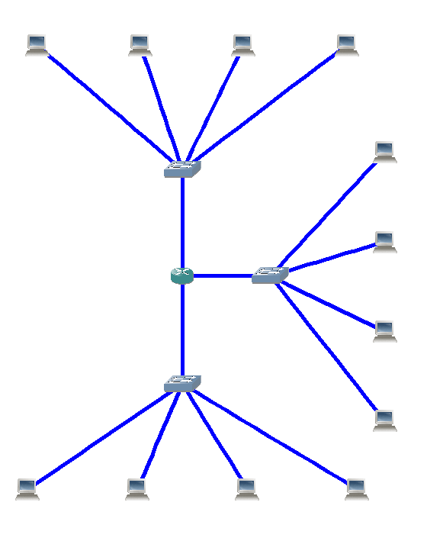
Telecommunication network :
Networking devices
Transmission links
Notes:
When I say network, what I mean is telecommunication network.
A network which nodes are networking devices

Slide 2



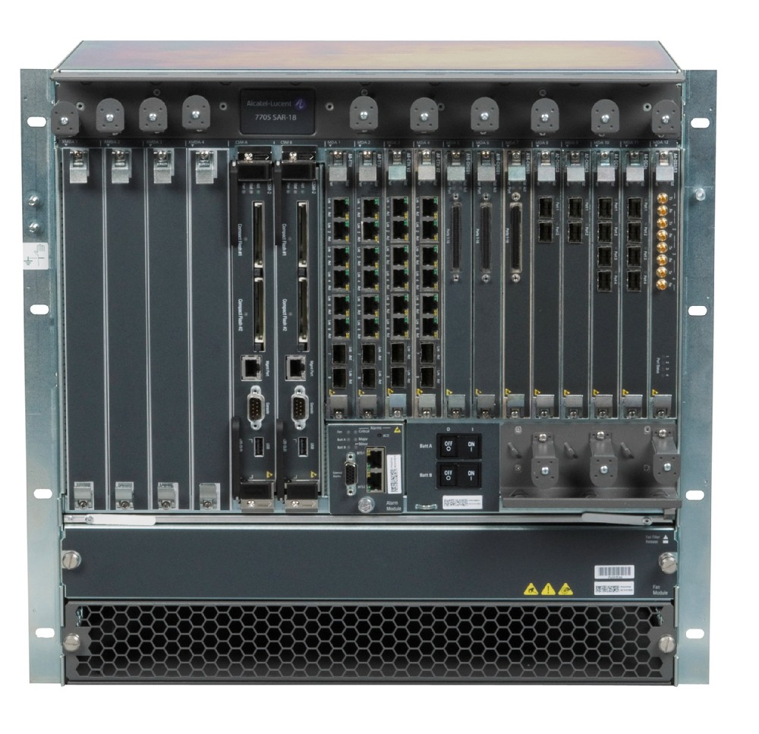
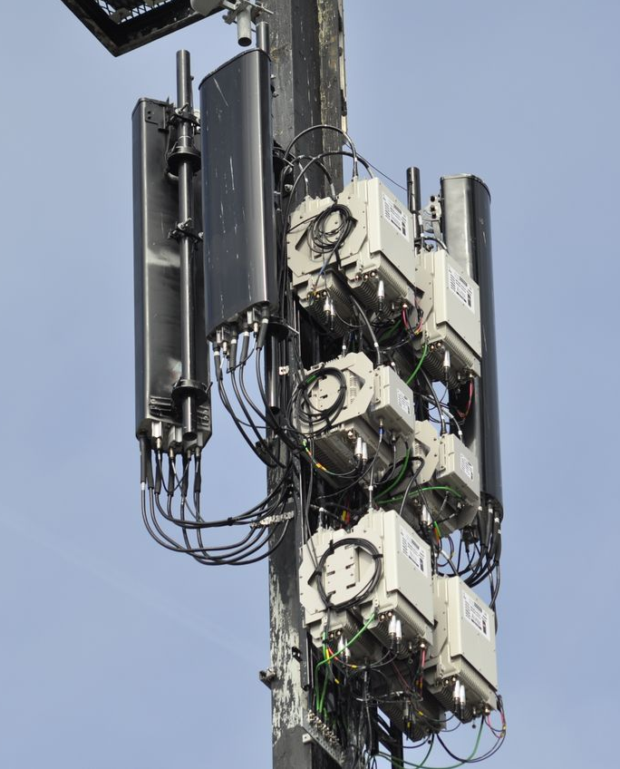
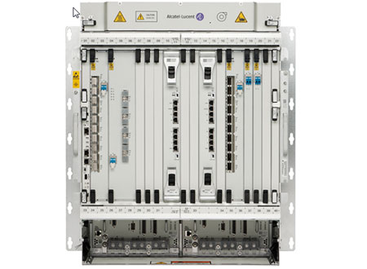
Nokia 7705 SAR
Nokia 1830 PSS
Nokia antenna
Router
Optical switch
Antenna
Notes:
Corporate
Not home
Big

Slide 3

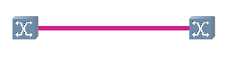

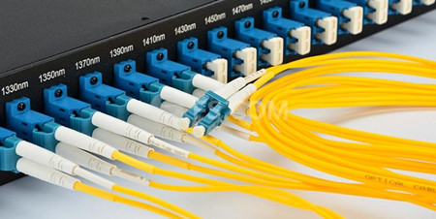
Ethernet (10G)
Optical fiber
Notes:
Modern network => 2 types
Ethernet (short)
Fiber (both)
Home vs pro (SFP)

Slide 4
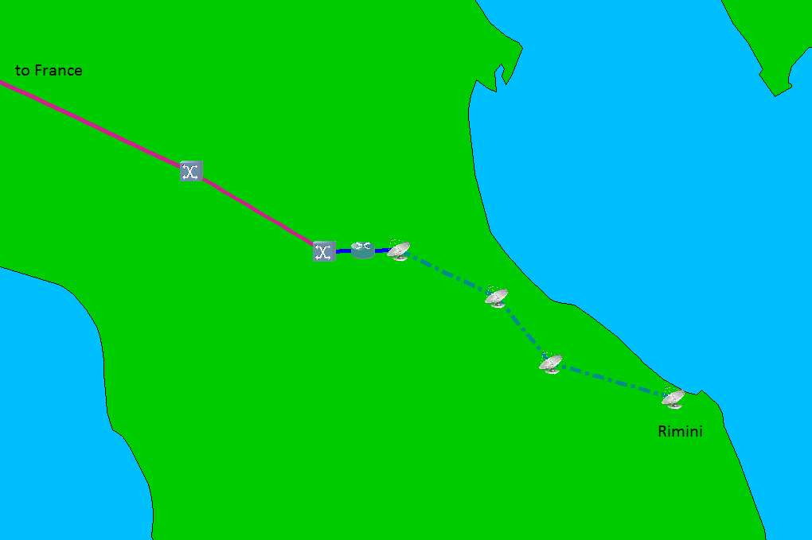
Forwarding decision
Microwave transmission
Electrical – Optical conversion
+
Wavelength multiplexing (WDM)
Notes:
Approximations, not accurate but close enough to the truth
3 main types
Microwave backhaul
Router => (important) forwarding, reach any part, brain
Routing table, association outgoing to an IP
IP packet, it looks at the destination IP address, and routing tells on which if to send
Oxc =>

Slide 5
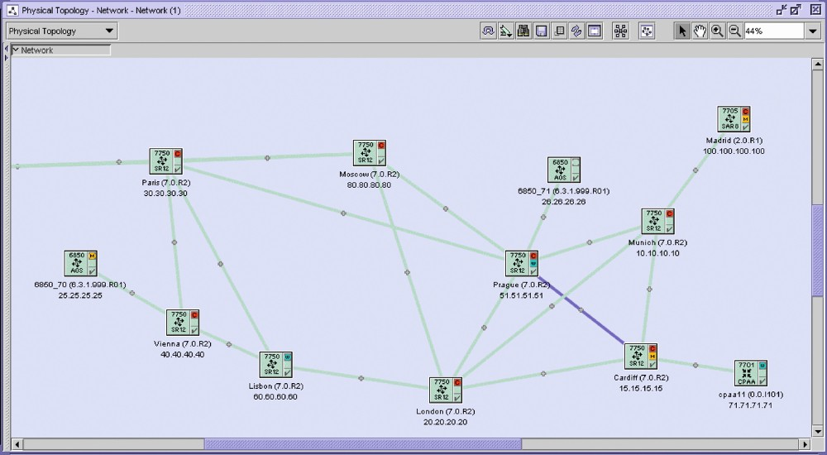
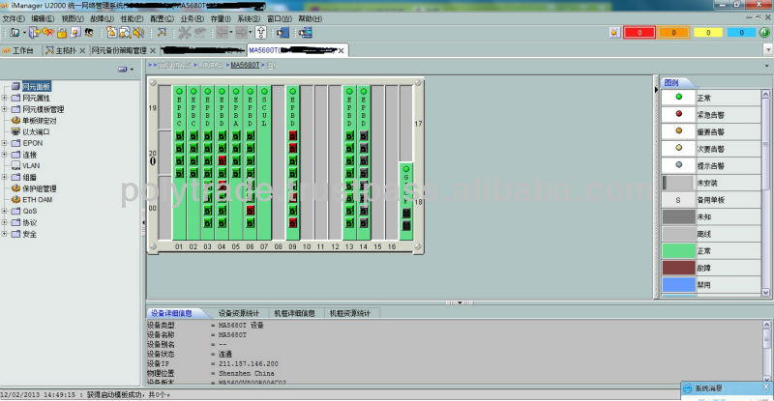

5620 SAM (Nokia)
Network Management System (NMS) are provided by equipment manufacturers :
Network visualization
Network inventory
Network provisioning
Network supervision
Network automation (not always)
U2000 (Huawei)
OneControl (Ciena)
Notes:
Company that sell device => NMS
Software => overview of the network and used for many things, incl…
« How to create a NMS using Python » // show you

Slide 6
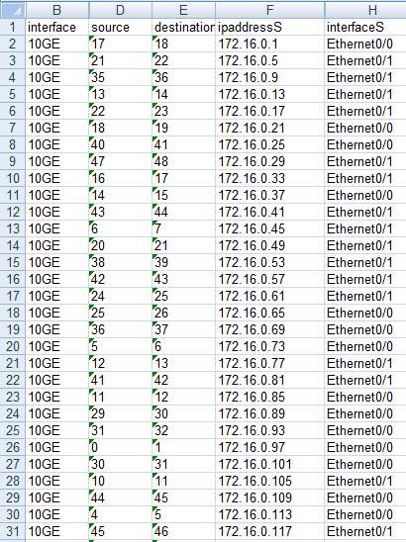
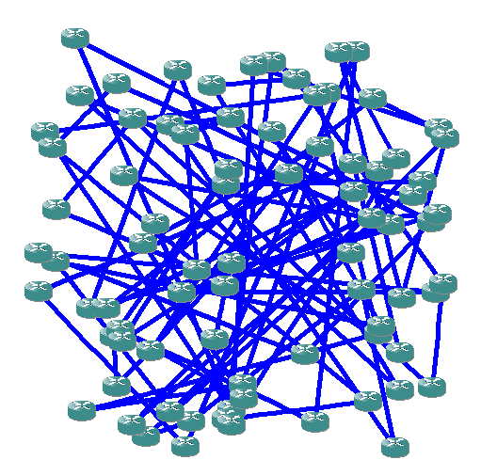
Network topology
Drawing of the associated network
Notes:
Information about network => nodes and links + location of the nodes
Xls, csv
Random => bad display

Slide 7
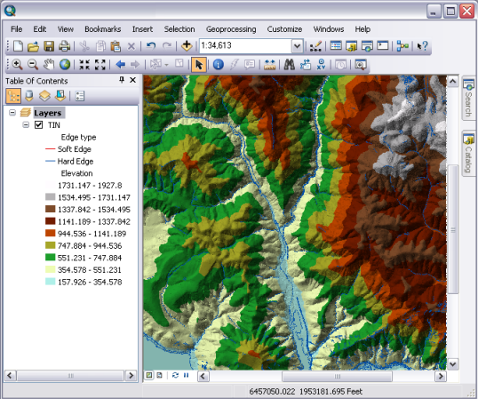
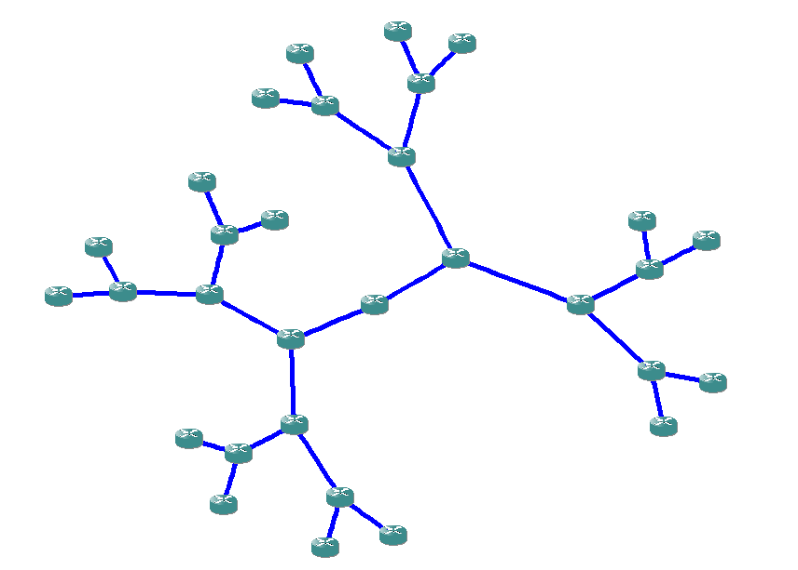
GPS coordinates
Drawing algorithm
Notes:
2 options
Use GPS coordinates
Graph drawing algo
Software to import, analyze visualize geographic data is called GIS
Geographic Information System
First part of the talk: how to create a lightweight GIS

Slide 8

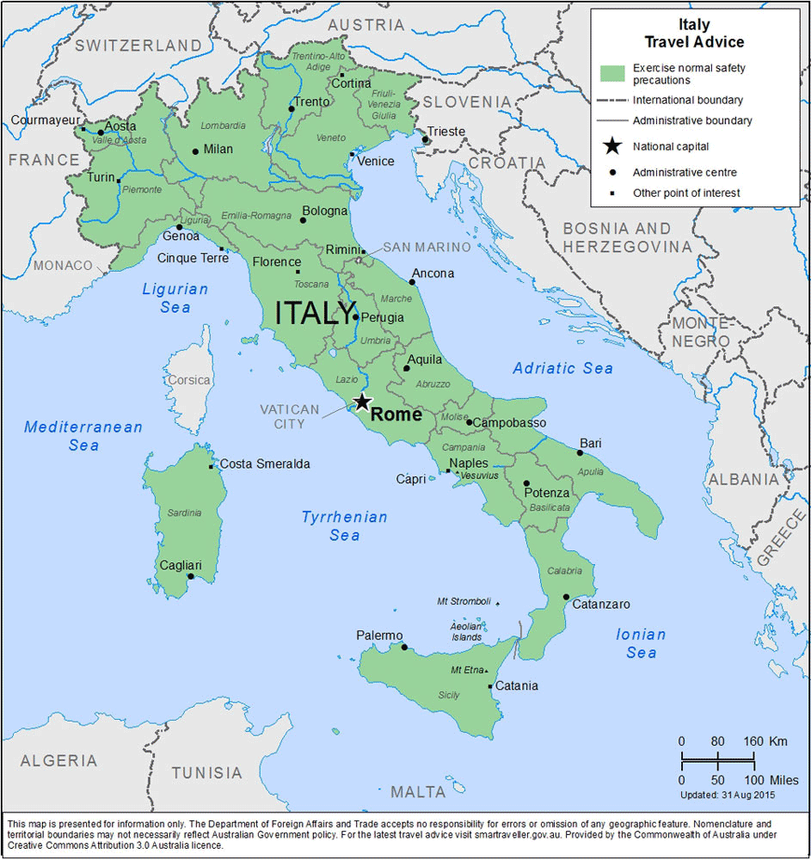
We need :
A GUI programming framework (tkinter)
A widget for drawing (Canvas)
A method to draw polygons
Notes:
First thing we need: GUI framework
Many: pyQT, pyGTK, pyside, wx_python
Tkinter interface to Tcl/tk
Then widget for drawing (all GUI framework have one)
Draw polygon: create polygon
Map = set of polygons

Slide 9


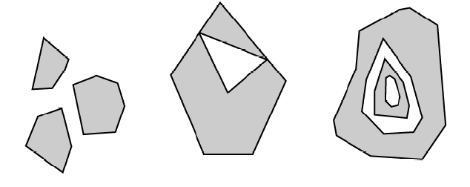
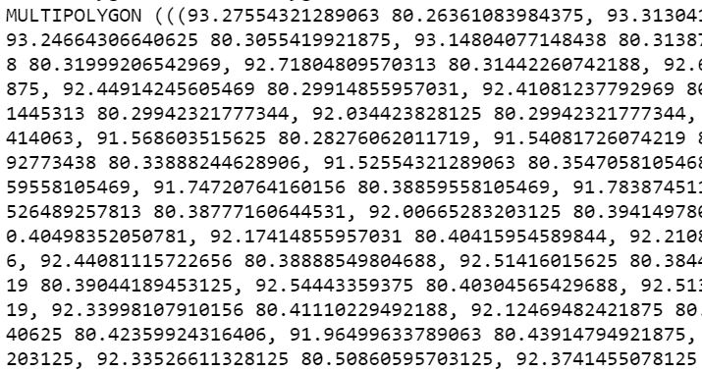
Polygons
Shapefile (.shp)
Multipolygons
Notes:
Need coordinates => shapefile
Contains shapes, the shapefile I use contain two types of shapes: polygons, and multipolygon.
Defined as set of points on earth, each point on the earth defined as longitude and latitude
Example of both
Create _polygon methods for polygon, decompose multipolygons

Slide 10
Shapes extraction
shapefile module
(pyshp)
Shapefile (.shp)
Notes:
Extract shapes => pyshp contains Reader object
Once done => polygons and multipolygons

Slide 11
Extract the polygons of a multipolygon
shapely module
Polygons and multipolygons
Polygons only
Notes:
To decompose => shapely
Method shape to convert shapefile multi into shapely multipolygon
Shapely multi are iterable, __iter__
Loop over shapely multi with simple for loop to yield polygons it contains

Slide 12
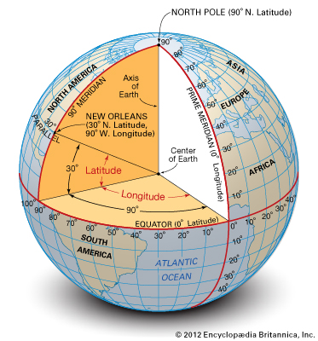
Point on the earth
(longitude, latitude)
Notes:
Shapefiles contain geographic coordinates defined by longitude, latitude
Angles
To draw polygons in a GUI, what we need is a planar coordinates, in pixel
=> conversion

Slide 13
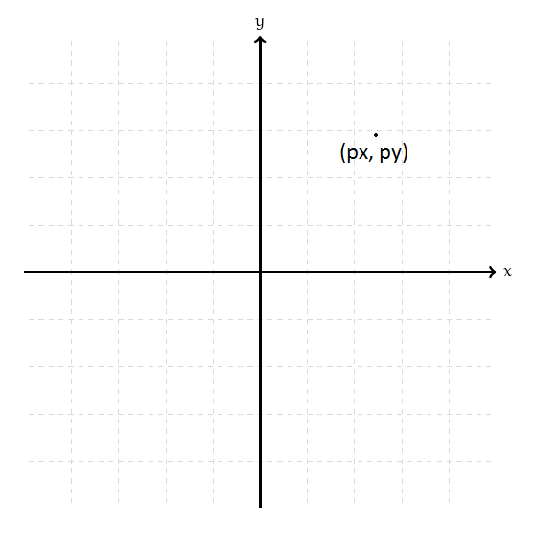
Point on the earth (3D) (longitude, latitude)
Point on a plan (2D)
(projected x, projected y)
Notes:
We’ll need to convert a point on a sphere (lon, lat) into a point in a plan
(call) projection
Remarkable theorem: (says) lose info in the process
It cannot be done without distortion. (distances, shapes, angles)
Mercator: preserves angles, not area

Slide 14
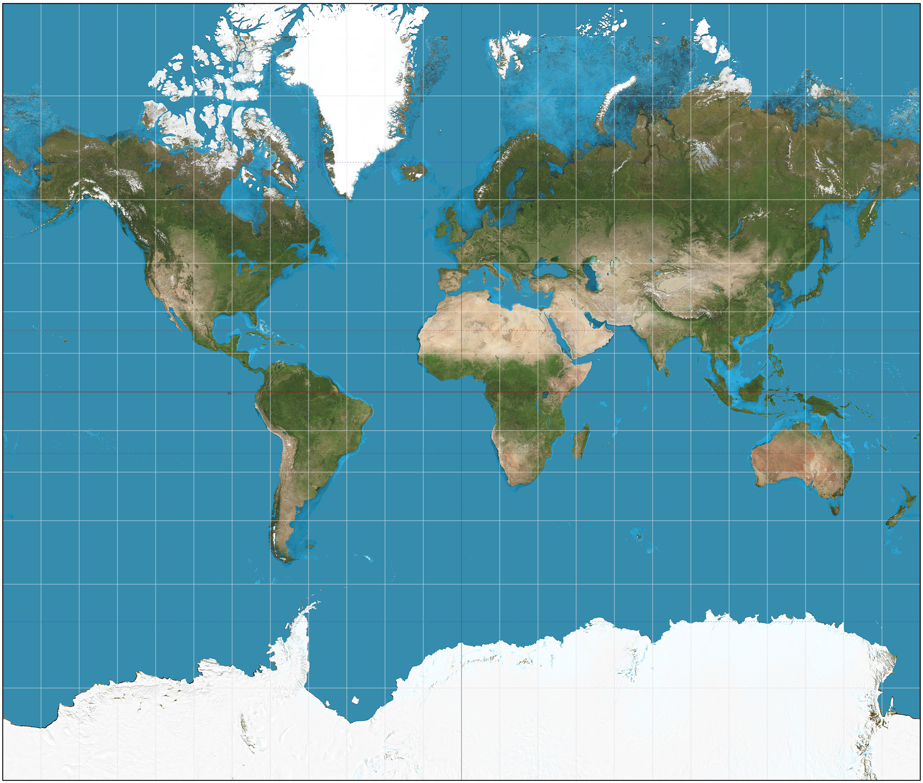

Convert geographic coordinates into projected coordinates :
pyproj
Mercator
Azimuthal orthographic
Notes:
Convert geo into proj: pyproj
Thousands available, pyproj allows us to choose whichever we like
Pyproj can convert geo to proj, proj, to geo, proj to proj

Slide 15
We need :
A GUI programming framework (tkinter)
A widget to draw polygons (tkinter’s Canvas)
A file that contains the map coordinates (shapefile)
A library to read shapefiles (pyshp)
A library to convert multipolygons into polygons (shapely)
A library to convert geographic coordinates into projected coordinates (pyproj)

Slide 16
Netmiko
SSH/Telnet
Paramiko
Exscript
NETCONF/YANG (multi-vendor, IETF)
Network programmability using YANG / NETCONF
OSS protocols: TL1, SNMP (pySNMP)
Puppet, Chef, Saltstack, HPNA
Configuration management tools
Ansible
Vendor-specific solution
Notes:
Overview network automation landscape
First, net engineers using for years: send command to conf or screenscrape
Py library for ssh connection: paramiko, complicated, built other librariries (most famous: exscript / netmiko)
Netconf: network config protocol, YANG: modeling language used to define data (pycon US)
OSS Protocol, S SNMP not simple (pySNMP)
Conf management: originates from DevOps world, also work on network devices (ansible gaining momentum)
Vendor-specific: API (software / web interface) basic automation tasks

Slide 17
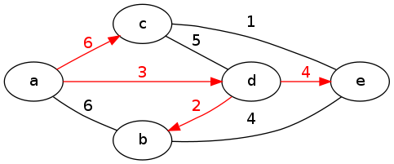
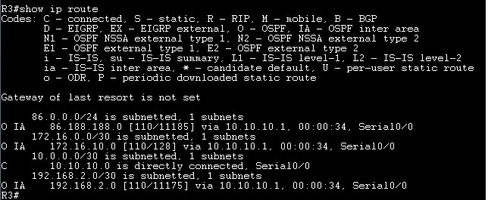
A router…
Run Dijkstra’s algorithm to find the Shortest Path Tree
Create the routing table: (destination outgoing interface)
(applies to link state protocols like OSPF and IS-IS)
Notes:
Forwarding decisions (where route traffic): taken by routers => rely on protocols (dynamically exchange info about ntw topo)
If router conf with link state (ospf/is-is), knows full topo, Dijkstra SP to any other part of ntw
Dijkstra result = SPT => build routing table

Slide 18
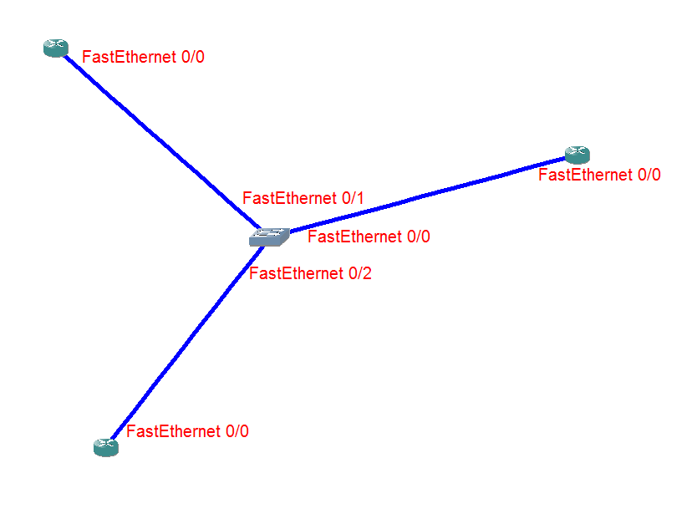
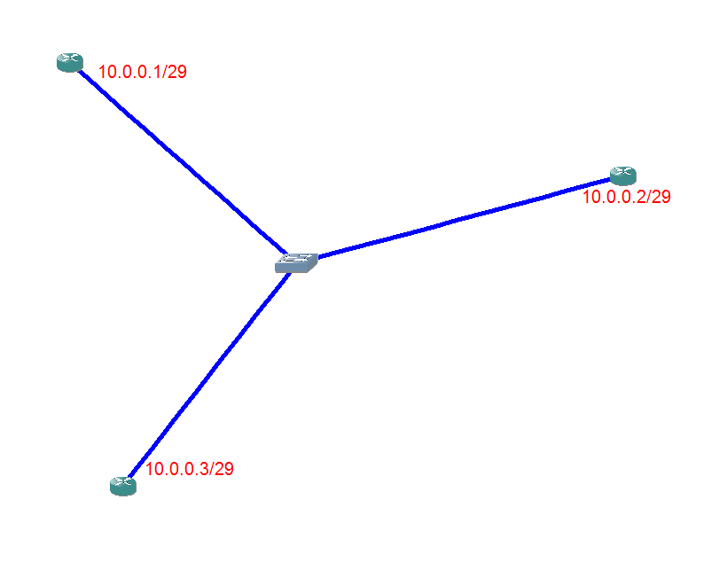
Allocate names to all interfaces
Allocate IP addresses to all interfaces
Choose a protocol (RIP, OSPF, IS-IS, …)
1
2
Notes:
Network simulation:
Create network topology
Decide which protocol the devices are conf with
Find out how the traffic is routed through the network (IP packet with given src / dest IP address, know which path it takes)
Generate conf of my device

Slide 19
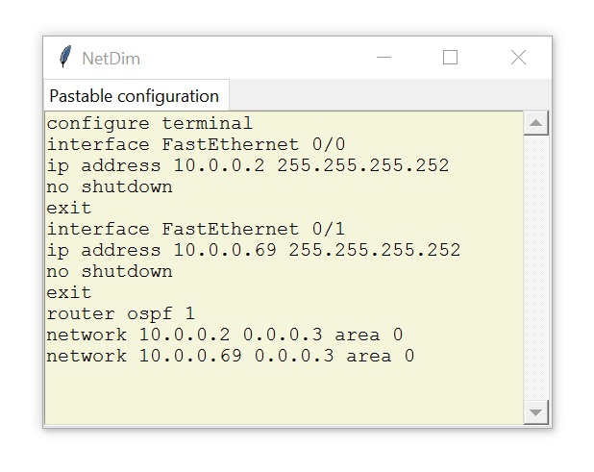
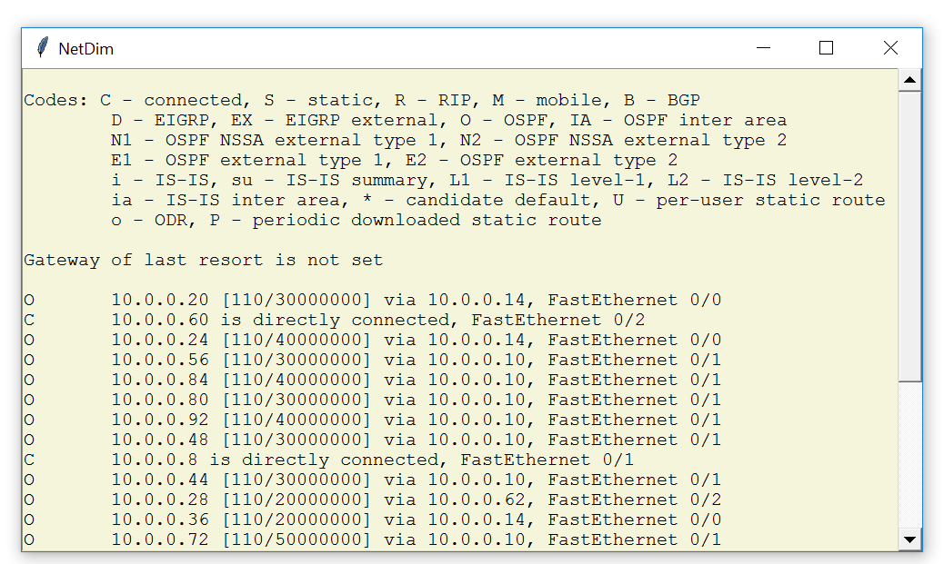
Generate the configuration
Create of the routing tables
4
5

Slide 20
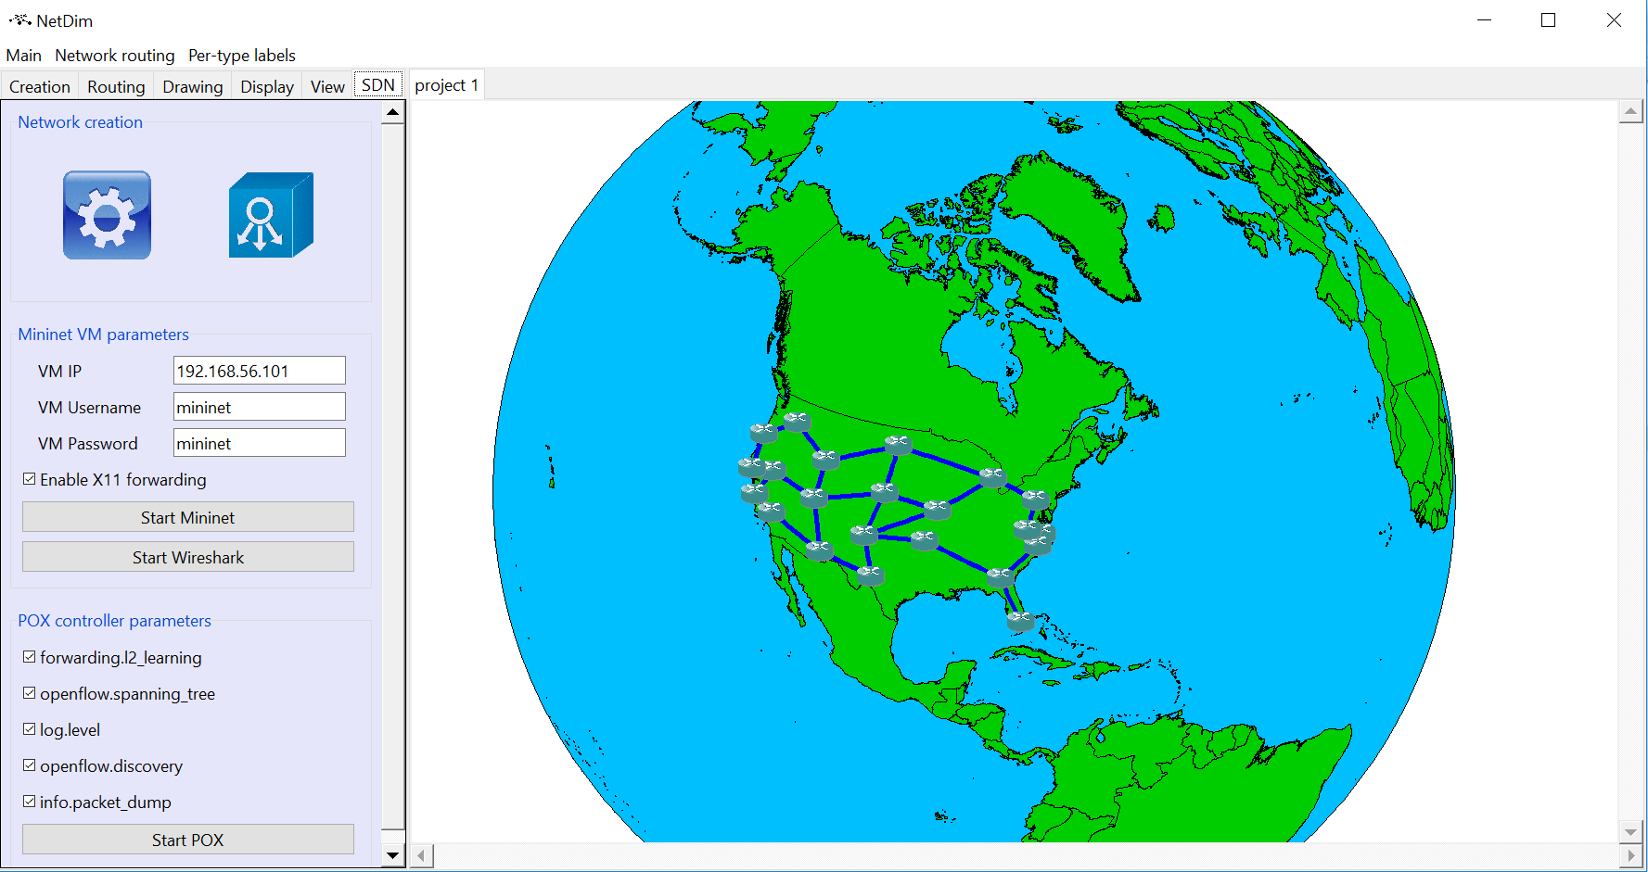
pyNMS
https://github.com/afourmy/pyNMS
100% Python
Open-source (GPLv3)
20K lines of code
PEP8 compliant
Design pattern: MVC
Vendor-agnostic
Tkinter-based GUI (possible switch to PyQT)
No stable release yet (some bug fixing needed)

Slide 21
Force-based algorithms
Visualization
Map drawing
Routing
Automatic configuration generation
Simulation
Capacity planning
Failure simulation
Automation
Emulation (Mininet, pox)
Linear programming (cvxopt)
Optimization
Metaheuristics

Slide 22
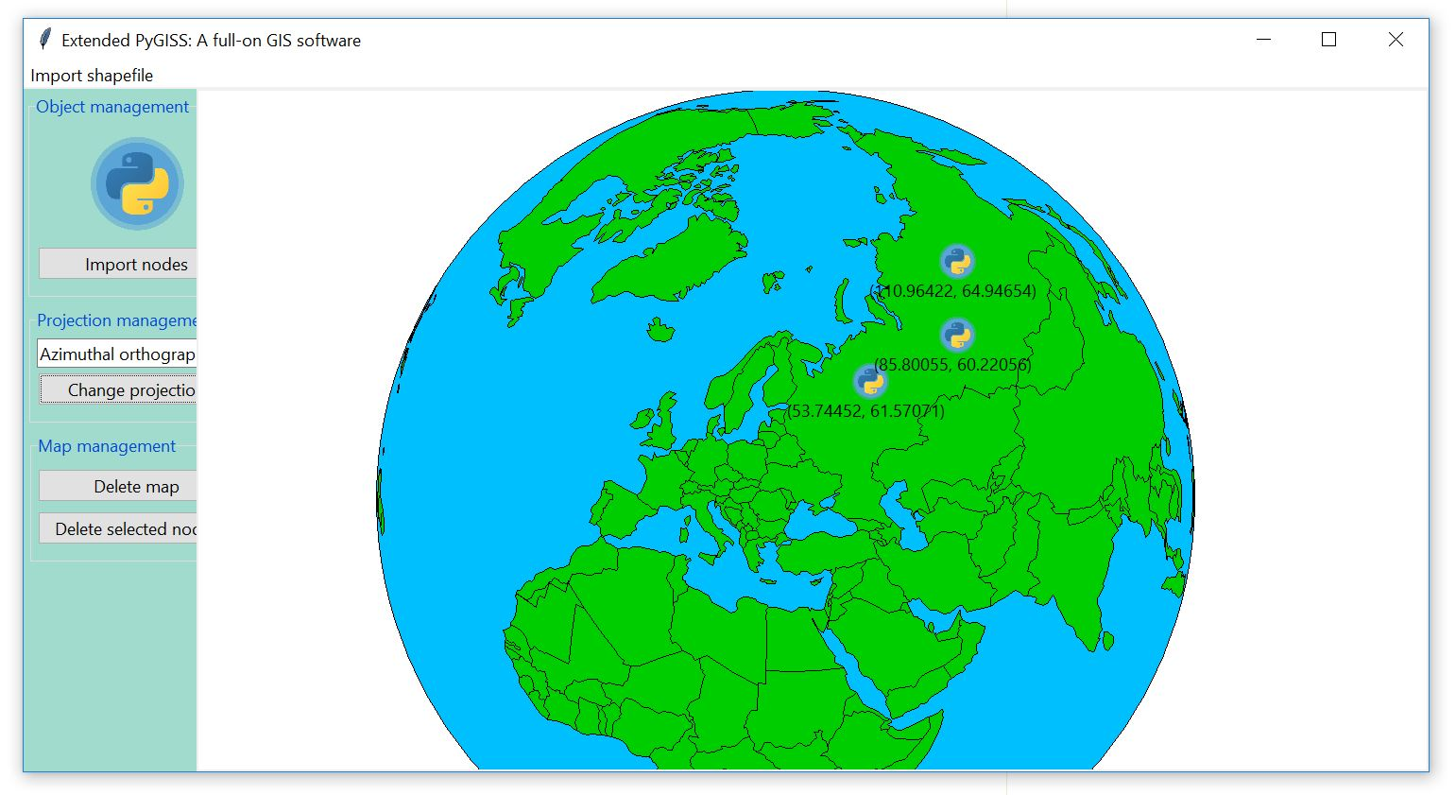
pyNMS
pyGISS (MIT)
https://github.com/afourmy/pyGISS

Slide 23
https://github.com/afourmy/pyNMS
https://github.com/afourmy/pyGISS
https://github.com/afourmy/EuroPython-2017
https://github.com/Toblerity/Shapely
https://github.com/jswhit/pyproj
https://github.com/knipknap/exscript
https://github.com/ktbyers/netmiko
https://github.com/ansible/ansible
Thank you
Notes:
Europython repository

